Slide 1

PC Hardware Essentials
Chapter 2:
Electricity and Power

Slide 2
Common Electrical Terms
Current
Flow of electricity
Circuit
Specific path, loop electricity flows along
Power
Amount of work current can produce
Resistance
Quality of impeding flow of electricity
Insulator
Device or material offering resistance

Slide 3
Common Electrical Terms
Conductor
Device or material allowing flow of electricity
Continuity
Describes existence of complete, working circuit
Capacitor
Device for storing electrical charge
Resistor
Device used to impede flow of electricity

Slide 4
Common Electrical Measurements
Amps
Current’s strength or rate of flow
Ohms
Conductor’s resistance to electricity
Volts
Electrical pressure (potential) in circuit
Watts
Electrical power in circuit range
Calculating voltage and power
Voltage = Current * Resistance
Power = Voltage * Current

Slide 5
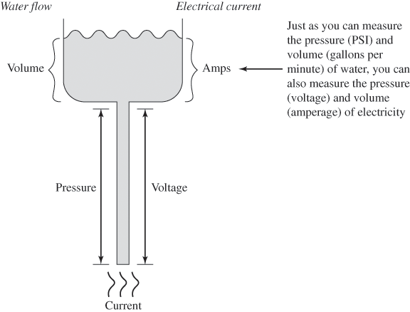
Comparing Electrical Current to Water Flow

Slide 6
Types of Current
AC (alternating current)
Current changes directions from positive to negative
60 times per second = 60 Hz
Provided by power companies
DC (direct current)
Constant flow from negative (hot) charge to positive (ground) charge
Type of power used in PCs

Slide 7
Multimeters
Main components
Digital or analog display
Two probes
Positive (red) probe
Negative (black) probe
Function selector switch
Select function
Select range of values expected
E.g. 3V – 12V, 105V-125V

Slide 8
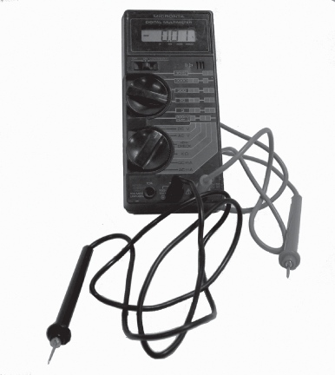
A Digital Multimeter

Slide 9
Measuring Voltage
Set function selector to measure AC (or DC) voltage
Choose voltage range
Usually 20V or lower
Hold black (negative) probe to ground point on circuit
Hold red (positive) probe to hot point on circuit

Slide 10
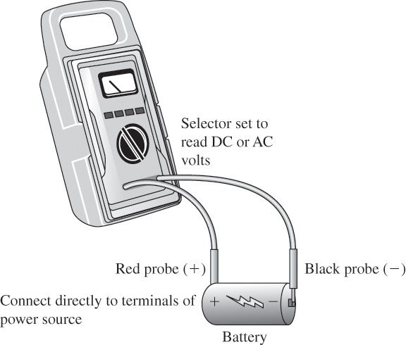
Measuring Voltage

Slide 11
Measuring Resistance
Ensure circuit is not powered
Set function to ohms and set appropriate range
Touch probes to two metal points
Multimeter should give signal (buzz or beep, etc.) to indicate continuity

Slide 12
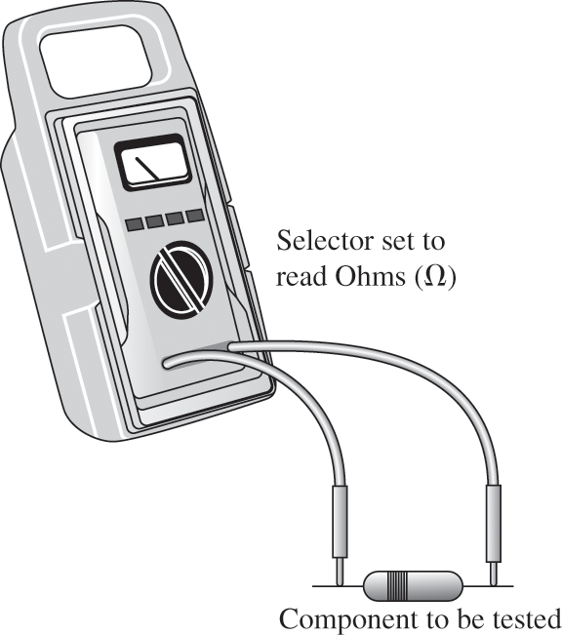
Measuring Resistance

Slide 13
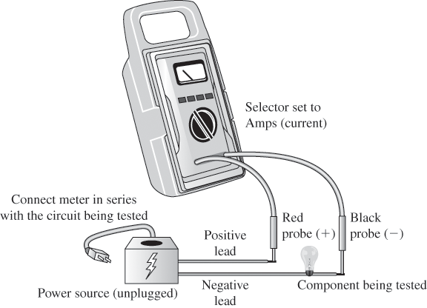
Measuring Current

Slide 14
Electrostatic Discharge (ESD)
Occurs when two objects of dissimilar charge come in contact with one another
PC electrical components use 3V – 5V
PC circuits can be destroyed by 30V
Small ESD charge: 3,000V
To protect against ESD:
Antistatic wrist strap
ESD mats
Antistatic bags for parts
Humidity control
Antistatic spray

Slide 15
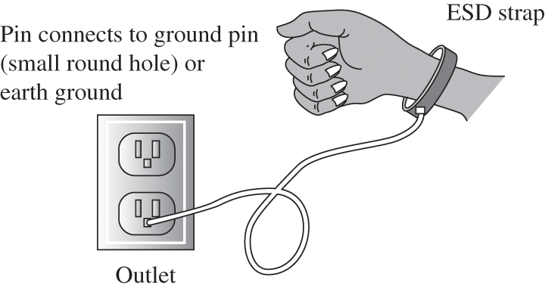
Connecting an Antistatic Wrist Strap

Slide 16
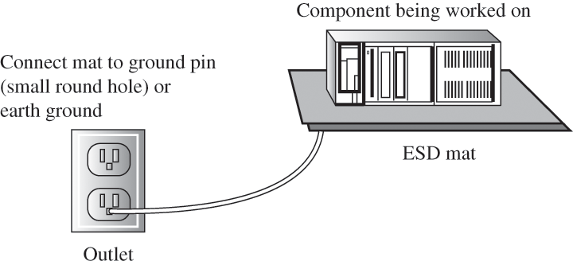
Using an ESD Mat

Slide 17
Power Problems
Two types of damage to PC by electrical forces
Catastrophic damage
Degradation
Three main classes of power problems
Power quality problems
Power overage problems
Undervoltage power problems

Slide 18
Power Problems
Power quality problems
Power fluctuations
Electromagnetic interference (EMI)
Radio frequency interference (RFI)
Power overage problems
Spikes
Surges
Undervoltage power problems
Sags
Brownouts
Blackouts

Slide 19
Power Problem Solutions
Line conditioners
Eliminate noise, most EMI, RFI
Produce “perfect” 110V/60Hz power
Surge protectors
Metal oxide varistor (MOV) takes hit from voltage spikes
Characteristics
MOV clamping speed, voltage
Energy absorption (Joules)
Line conditioning
Protection indicators

Slide 20
Power Problem Solutions
Backup power supplies
Keep power at 110V
Two types
Standby power supply (SPS)
Switches to battery when line voltage drops below cutover threshold
Uninterruptible power supply (UPS)
Power run constantly from outlet to battery and then to PC

Slide 21
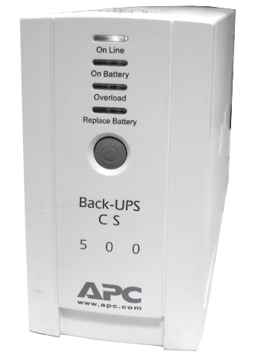
Uninterruptible Power Supply (UPS)

Slide 22
Power Supplies
Rated in watts
Provide standard voltages to motherboard and drives (+5V, +12V, -5V, -12v, +3.3V)
Carry lethal amounts of current
Components include:
Power cord
Pass-through connectors
Power switch
110/220V selector switch
Power supply fan

Slide 23
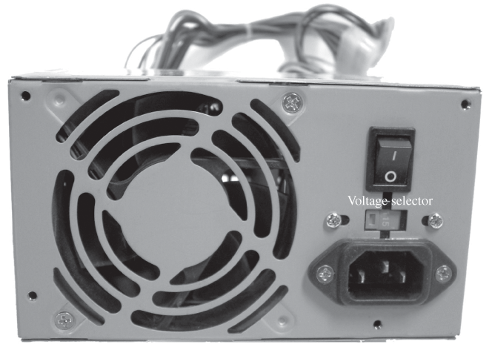
Power Supply

Slide 24
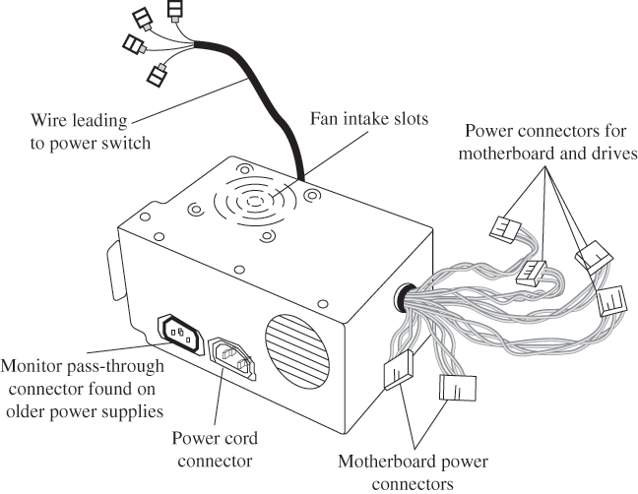
Power Supply Components

Slide 25
Power Supply Form Factors
Power supply must match:
Form factor of case
Motherboard power requirements
Power supply form factors
Older form factors: AT, Baby AT, LPX
ATX (NLX)
Uses single 20-pin P1 motherboard connector
Soft-power feature
SFX (mini or micro ATX)
Smaller form factor
ATX 12V
Additional 4-pin 12V connector

Slide 26
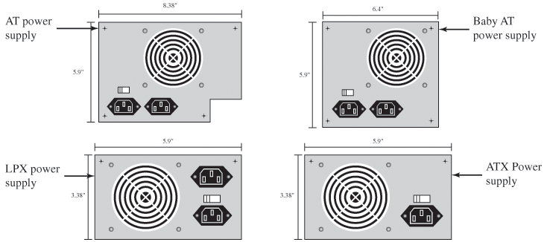
Power Supply Form Factors

Slide 27
Power Supply Connectors
Floppy drive connectors (Berg connectors)
Standard peripheral power connectors (Molex connectors)
Motherboard connectors
AT system connectors: P8/P9
ATX system connectors:
P1 (20-pin or 24-pin)
Auxiliary power connector (6-pin Molex)
ATX 12V (P4) connector
PCI Express connectors
SATA drive connectors
Fan connectors

Slide 28
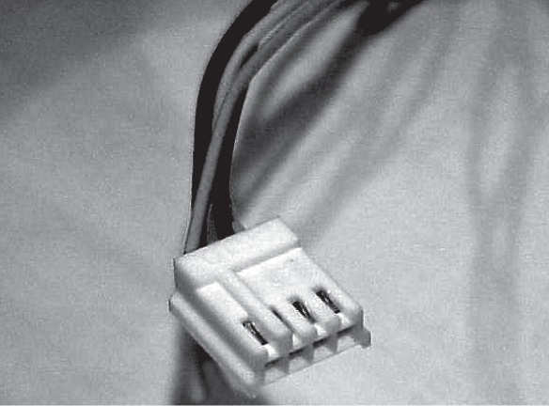
Floppy Drive Connector (Berg)

Slide 29
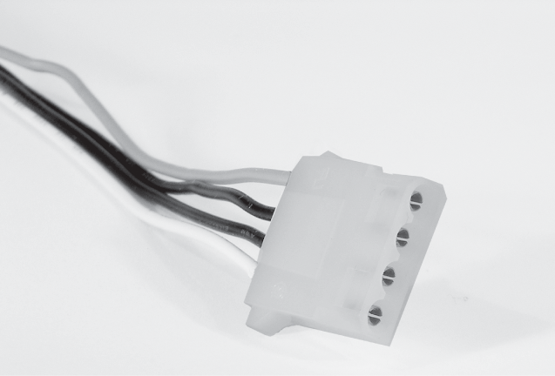
Standard Peripheral Power Connector (Molex)

Slide 30
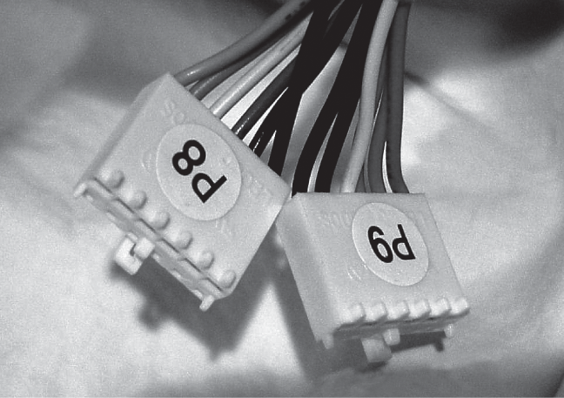
P8/P9 Connectors

Slide 31
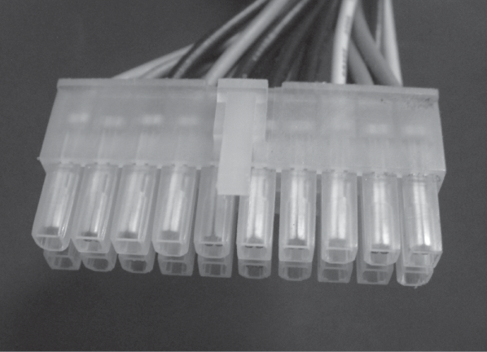
ATX 20-pin P1 Connector

Slide 32
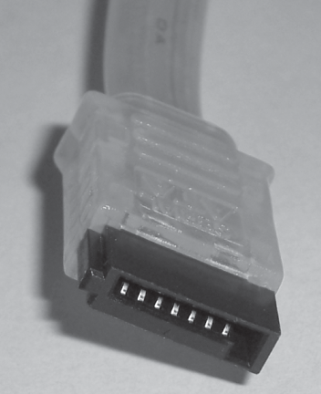
SATA Drive Connector

Slide 33
Replacing a Power Supply
Unplug PC power
Open case, disconnect all PSU connectors
Remove mounting screws, lift PSU out
Ensure new PSU voltage level set
Insert PSU, reattach with mounting screws
Reconnect to motherboard, drives, fan, etc.
Replace case cover and power cord
Power PC, verify fan is on and PC, drives functioning

Slide 34
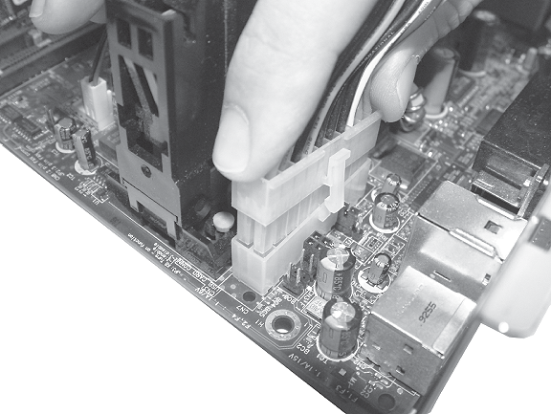
Installing the ATX System Connector

Slide 35
Maintaining and Upgrading Power Supplies
Be alert to any signs heat is not being dissipated by power supply fan or case fans
Keep PC closed to allow air flow and cooling
Some component upgrades (e.g. SATA drives, powerful CPUs) may require upgrading power supply
Power supply should provide 10 % more than power requirements of all components

Slide 36
Troubleshooting Power Supplies
Common power problems
No power when power button pressed
Power cord not pushed in
Front panel power switch connector to motherboard not connected
Power supply may have own power switch which is turned off
Computer powers on, then powers down
CPU fan problem
Loud bang, smoke at back of case
Power supply set to wrong voltage

Slide 37
Troubleshooting Steps
Ensure PSU receiving power
Is power supply fan on?
Check connections with power cord, power strips, outlet
Ensure voltage switch set correctly
Check connections to motherboard

Slide 38
Summary
Power supply converts AC current from wall outlets to DC current PC uses.
Electricity measure in amps, volts, ohms, watts.
Multimeters consist of analog or digital display, two probes, function selector switch.
Main protection against ESD is use of antistatic wrist straps and ESD mats. Other techniques include antistatic bags, humidity control, antistatic spray.

Slide 39
Summary
Three main types of power problems: Power quality problems (EMI, RFI); power overage problems (spikes, surges); and power undervoltage problems (sags, brownouts, blackouts).
Solutions to power problems include line conditioners, surge protectors, and backup power supplies (SPSs and UPSs).

Slide 40
Summary
Power supplies rated in watts, provide standard voltages (3.3V, +5V, -5V, +12V, -12V) to motherboard and drives. Common form factors today are Baby AT, ATX, ATX 12V.
Common PSU power connectors: Floppy drive (Berg), standard peripheral (Molex); motherboard connectors (P8/P9, P1, P4).
Power supply should provide at least 10% more power than PC system components require.

Slide 41
Summary
When installing PSU, ensure it is set for correct input voltage (110V in U.S.).
You can tell power supply is functioning if you hear PSU fan.
When troubleshooting PSU, check wall outlet, power cord, power switch, power strips, voltage switch, motherboard connectors.

Slide 42
Key Terms
Alternating current (AC)
Amps
Antistatic bag
Antistatic wrist strap
Auto-ranging multimeter
Berg connector
Brownout
Capacitor
Circuit
Conductor
Continuity
Current
Cutover threshold
Direct current (DC)
Electromagnetic interference (EMI)

Slide 43
Key Terms
Electrostatic discharge (ESD)
ESD mat
EST wrist strap
Floppy drive power connector (Berg connector)
Insulator
Line conditioner
Line power
Molex connector
Multimeter
Ohms
Power
Radio frequency interference (RFI)
Resistance
Resistor

Slide 44
Key Terms
Sag
Spike
Standard peripheral power connector (Molex)
Standby power supply (SPS)
Surge
Surge protector
Uninterruptible power supply (UPS)
Voltage
Volts
Watts

Slide 45
Copyright Notice
Copyright 2008 John Wiley & Sons, Inc. All rights reserved. Reproduction or translation of this work beyond that permitted in section 117 of the 1976 United States Copyright Act without express permission of the copyright owner is unlawful. Requests for further information should be addressed to the Permissions Department, John Wiley & Sons, Inc. The purchaser may make back-up copies for his/her own use only and not for distribution or resale. The Publisher assumes no responsibility for errors, omissions, or damages caused by the use of these programs or from the use of the information herein.

